Slide 1



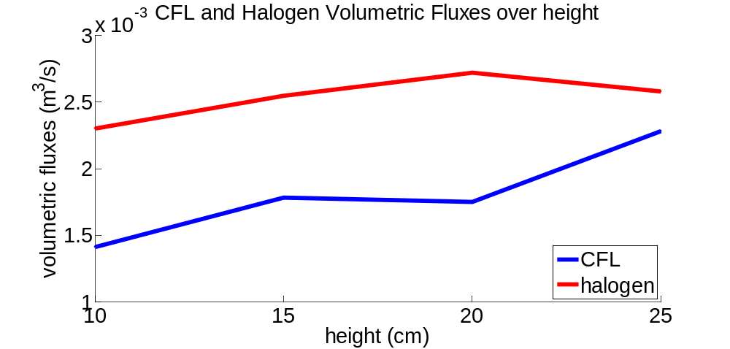
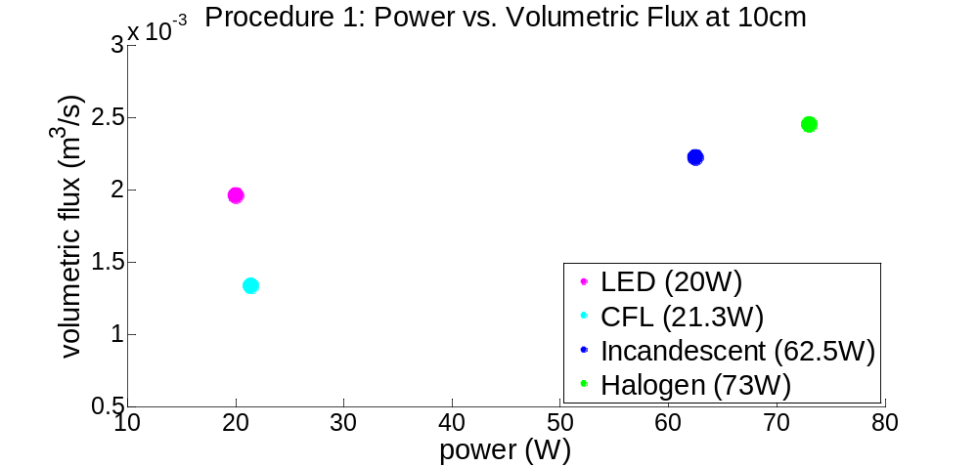
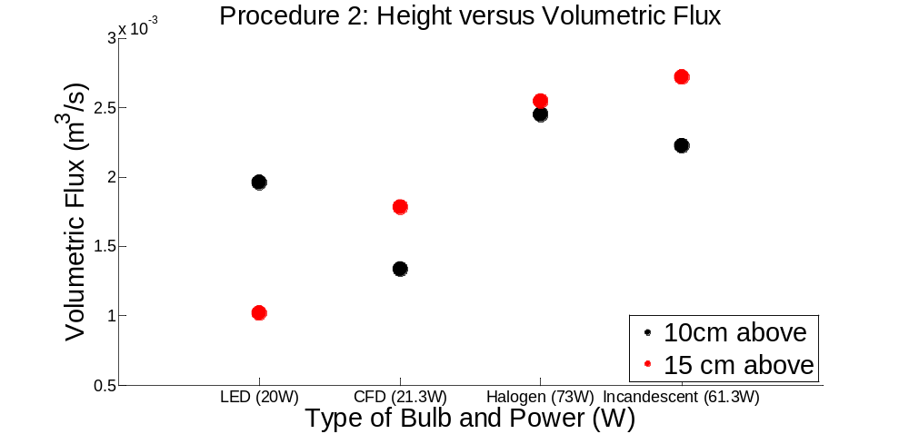
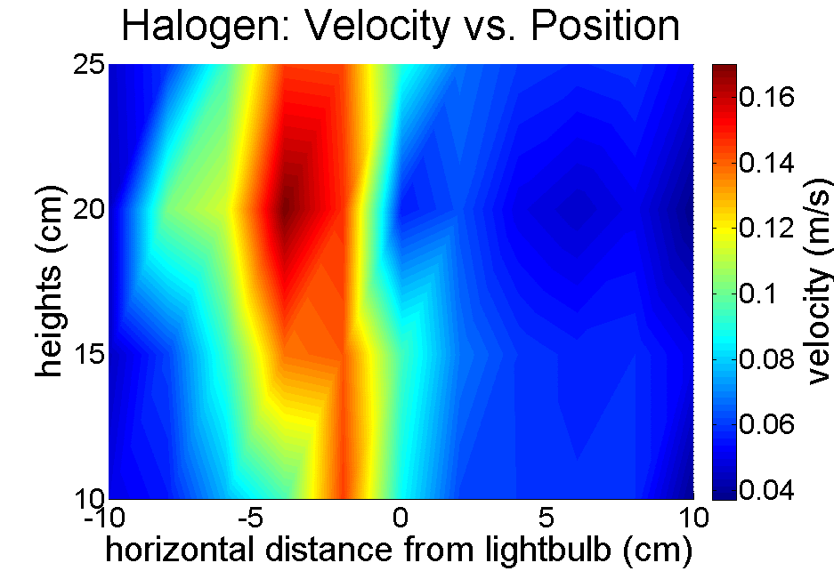
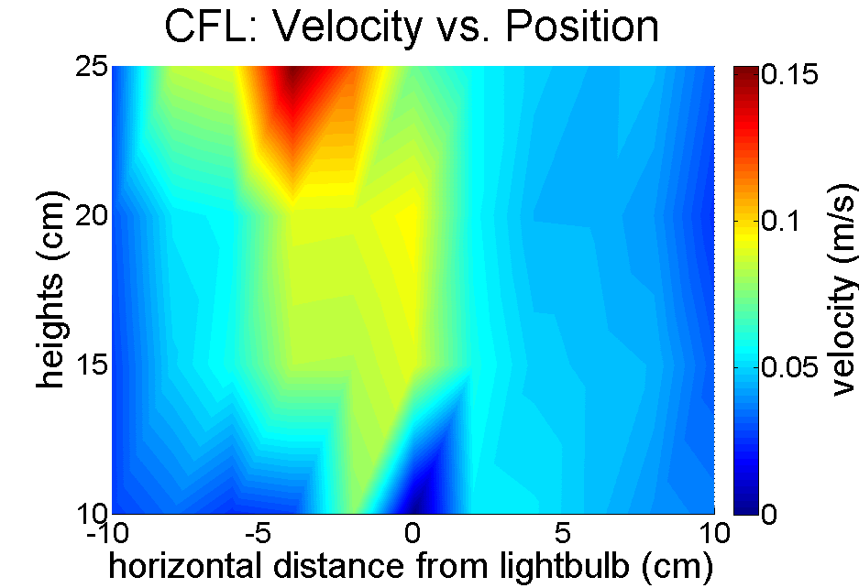
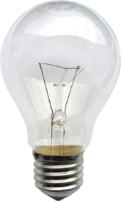
Ada Shaw, Matthew Vannucci
Department of Civil and Environmental Engineering, University of California at Berkeley, Berkeley, CA 947204
Abstract
Determine the volumetric flux above various types of lightbulbs to explore the relationship between flow rate and power consumption.
Results and Discussions.
Introduction
Motivation
Air flow due to heated objects is a common indoor source of pollutant mixing and can inform current models.
Hypotheses
Convective heat loss creates air motion because heat transfer from the object to the surrounding air increases the buoyancy, starting a flow.
Higher power bulbs will have greater heat losses and result in increased air flow.
As air rises in a tight column right above the bulb, nearby air may become entrained, leading to the volumetric flow increasing with height over the bulb.
Procedure 3 for the halogen and CFL light bulbs
Zero velocity was observed directly above the fluorescent and incandescent bulbs at 10 cm. This was hypothesized to be due to radial volumetric entrainment outside of that area resulting in a small patch of low-velocity air.
The thermal plume was more pronounced left of the light bulb, likely due to minute differences in pressure, temperature, etc in the room.
The non-LED lightbulbs had increased volumetric flux with increased power because their resistive filaments expelled more heat at higher wattages.
For the conventional non-LED lightbulb, entrainment did occur, leading to higher volumetric flux at increased height up to 25 cm.
Procedure 1 measures the relationship between volumetric flux and power usage.
Materials and Methods
Light bulbs used:
  CFD (21.3W, 23W equivalent, 1600 lumens)
  LED (20W, 100W equivalent, 1600 lumens)
  Incandescent (62.5W, 60W equivalent, 550 lumens)
  Halogen (72W equivalent, 1120 lumens )
Placed in a 4’ x 4’ x 8’ high chamber, with plastic sheeting walls
Measurements were taken every 2 cm in a horizontal row extending ±10 cm over the bulb.
  Procedure 1: Air velocity measurements were taken at 10cm above all lightbulbs to compare power vs flow
  Procedure 2: Air velocity measurements were taken at 15cm above all the lightbulbs to compare the flow at different heights.
  Procedure 3: Air velocity measurements were taken at 2 additional heights, 20 and 25 cm, for the halogen and fluorescent bulbs to create contour maps of air velocity.
Conclusions
For traditional lightbulb geometries where the greatest natural convection air buoyancy exists above the bulb, power was directly related to volumetric flux and air entrainment was observed as height increased.
Models of indoor air quality should be adapted to the heat sources in the room. A LED lighted room versus a CFL, incandescent, or halogen one will have different air flow patterns due to differences in volumetric flow caused be each style of lightbulb
What’s next?
In order to fully make conclusions upon the nature of convective air flow over indoor heat sources and how they comparatively drive heat flow in a room, other types of convectively heating appliances should be evaluated as well, such as wires, electronics, and other shapes of lightbulbs.
Further studies into how temperature profiles caused by these appliances are related to the volumetric flux entrainment.
10 cm
0 cm
10 cm
Height:
Procedure 1: 10 cm
Procedure 2:15 cm (for all lightbulbs)
Procedure 3:20 cm, 25 cm
(for CFL and Halogen)
Procedure 2 measures the velocity at 15 cm above all four bulbs separately to see if additional entrainment occurs as the plume rises above the 10 cm measurement.
References
Kaye, N. B., and G. R. Hunt. "The effect of floor heat source area on the induced airflow in a room." Building and Environment 45.4 (2010): 839-847.
Kaye, N. B., and G. R. Hunt. "An experimental study of large area source turbulent plumes." International Journal of Heat and Fluid Flow 30.6 (2009): 1099-1105.
Fundamentals of Momentum, Heat and Mass Transfer. S.l.: John Wiley & Sons, 2013. Print.
Procedure 3 includes all the gridded measurements made on the CFL and halogen bulbs up to 25 cm above. Note the zero velocity directly above the bulb at 10 cm vertical height.
Acknowledgements
Prof. William Nazaroff, Vineet J Nair, Center for Built Environment

